Slide 1

Microprocessor and Microcontroller Lab
Intelligent smart home automation using Arduino simulator

Slide 2
Microprocessor and Microcontroller Lab
Afsana Kabir Sinthia Id: 182002068
Razia Sultana Urmi Id: 182002079
Md.Sofiullah Asrafi Id: 182002122
Presented by:
Sec: 182DB
Dept: CSE
Presented To:
All

Slide 3


Microprocessor and Microcontroller Lab
CONTENT OF
THIS SLIDE
Project Name and Intro
Aim of project
Requirement
Conclusion

Slide 4
Microprocessor and Microcontroller Lab
Project
Introduction
Intelligent smart home automation using Arduino simulator
We have come up with a system called Arduino based home automation using Bluetooth. This system is super-cost effective and can give the user, the ability to control any electronic device without even spending for a remote control. This project helps the user to control all the electronic devices using his/her smartphone.
Objectives
Implementation of Intelligent smart home automation using Arduino simulator.

Slide 5
Microprocessor and Microcontroller Lab
Aim of project
And Requirement
The aim of this project is to control different home appliances using a smartphone.
Requirement
Hardware
Software
Breadboard
Arduino
proteus professional
App
Arduino simulator
Bluetooth enabled smartphone

Slide 6


Microprocessor and Microcontroller Lab
Procedures
Of Project
Step
Proteus Part: | Create circuit.
Mit a2 app | Create mit app
Coding | Coding in Arduino software
CPU

Slide 7
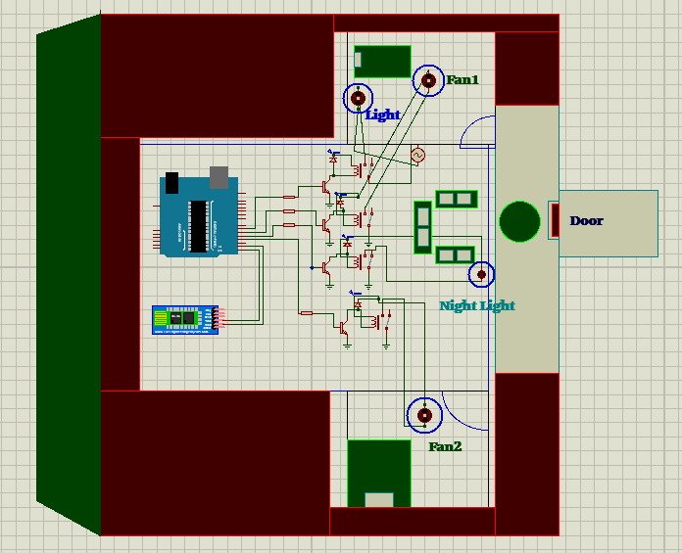
Microprocessor and Microcontroller Lab
Project Output
And Project Budget

Slide 8
Microprocessor and Microcontroller Lab
Future Work
And Project Budget
The project can be further expanded to a smart home automation system by including some sensors like light sensors, temperature sensors, safety sensors etc. and automatically adjust different parameters like room lighting, air conditioning (room temperature), door locks etc. and transmit the information to our phone .

Slide 9
Microprocessor and Microcontroller Lab
Conclusion
And Project Budget
Project Budget : Depends on how many instruments are used . basically its depends online and offline base project.
Conclusion: finally we got properly output using smartphone by the Bluetooth connection, we able to Control device without any problem.

Slide 10
THANK YOU

